Slide 1

Wojciech Kaczmarski, SP5WWP
M17 Project
m17project.org

Slide 2
What is M17?
A digital protocol designed by hams, for hams
A response to growing community of digital mode users
A way to get free from patent encumbrances, licenses etc.
A chance to bring back digital radio to the experimenting side of amateur radio
Uses Codec 2

Slide 3
Why is M17 different?
Created for fun, not profit
Based on Codec 2, not proprietary vocoders
Development driven by users, not by a single manufacturer
Extensible – use cases can be added over time

Slide 4

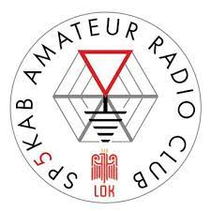
The Origins
Started in 2019 in SP5KAB (Warsaw, Poland)
SP5KAB has a long history, dating back to early 1950s

Slide 5
Who is behind it?
2019 – a handful of hams from my local ARC
2022 – a large, multinational group of ham radio operators

Slide 6
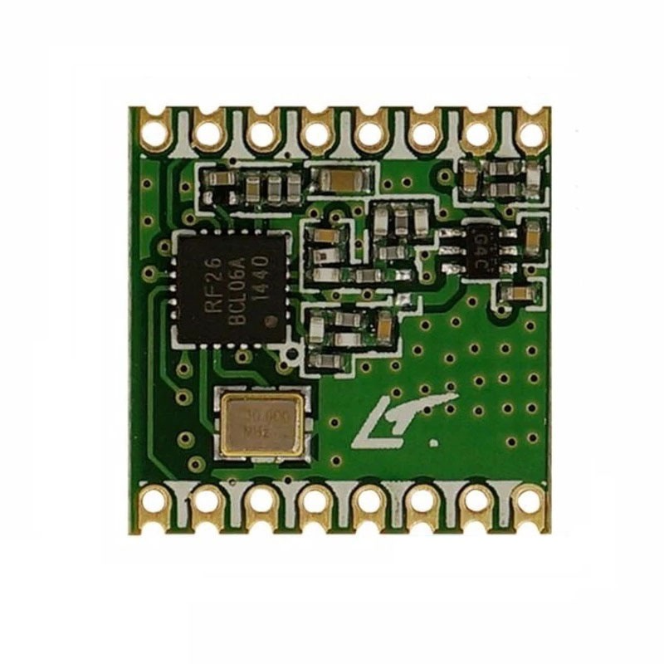
2019
First experiments with Codec 2 and STM32s
Initial tests with RFM26W modules (Si4463)

Slide 7
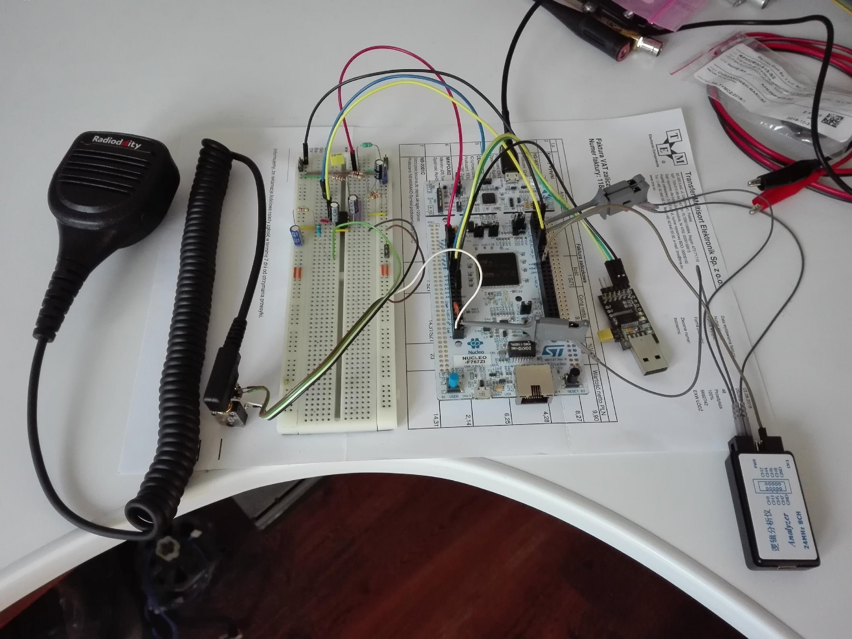

Slide 8
2019
First prototype of an M17-compatible handheld created – TR-9
Dan Romanchik’s blog entry (M17, an open-source, DMR like system) – pivot point for the project

Slide 9
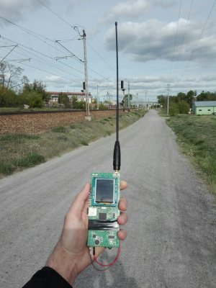

Slide 10
2020
Media coverage increases via Twitter, blogs
Protocol specification refinement
OpenRTX project starts
Doug, AD8DP, adds M17 to DroidStar
Tom, N7TAE, creates mvoice
Rob, WX9O, creates m17-cxx-demod command line encoder/decoder tools

Slide 11
2021
Significant financial assistance via ARDC grant
We win the ARRL’s Technical Innovation Award
MMDVM and OpenWebRX start to support M17
First QO-100 satellite tests
SDR++ adds M17 support

Slide 12
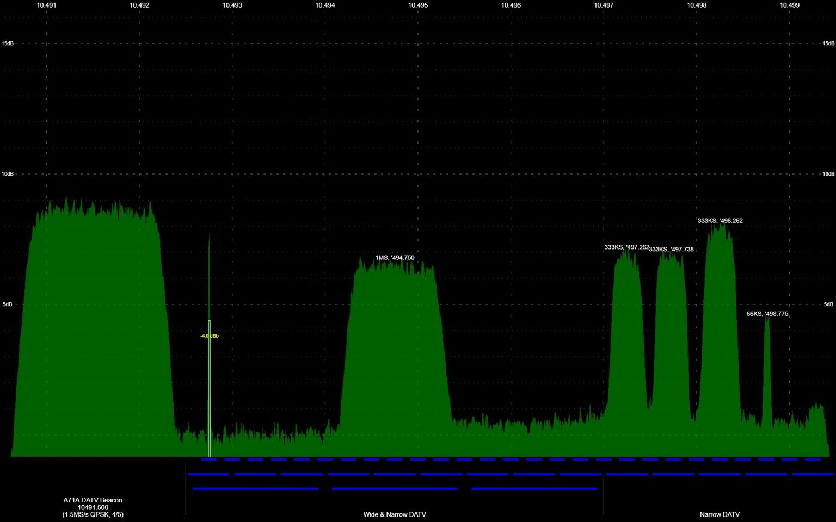
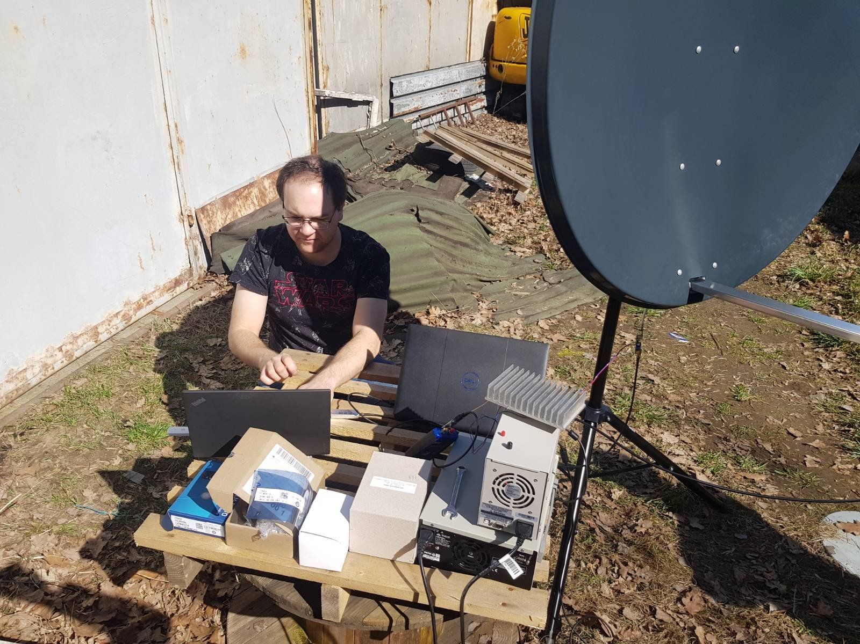
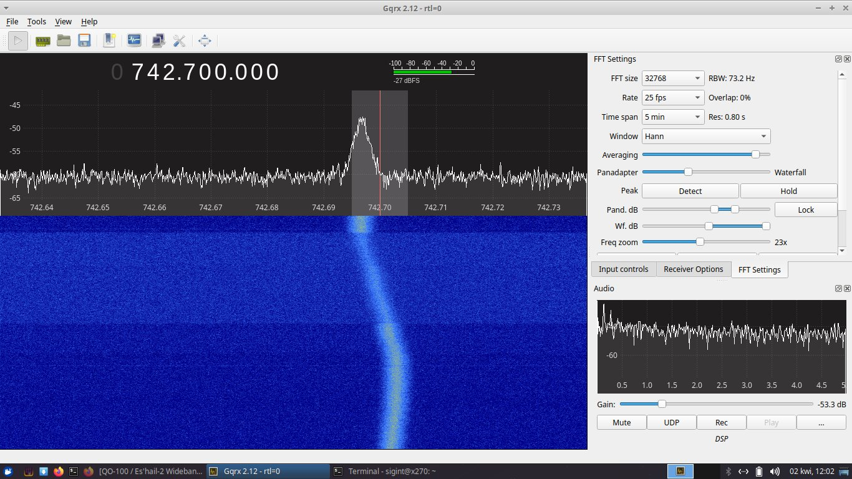

Slide 13
2022
Successful QO-100 loopback test by Charles G4GUO
Ongoing specification improvements by Jay KA1PQK
Upcoming OOT GNU Radio blocks by Dave N1AI
Module17 modem board by Mathis DB9MAT
OpenRTX supports M17 on MD-(UV)380

Slide 14
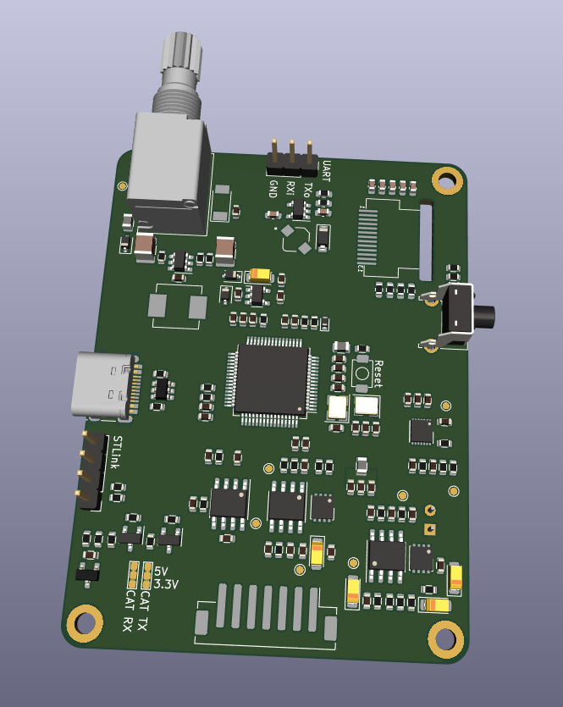
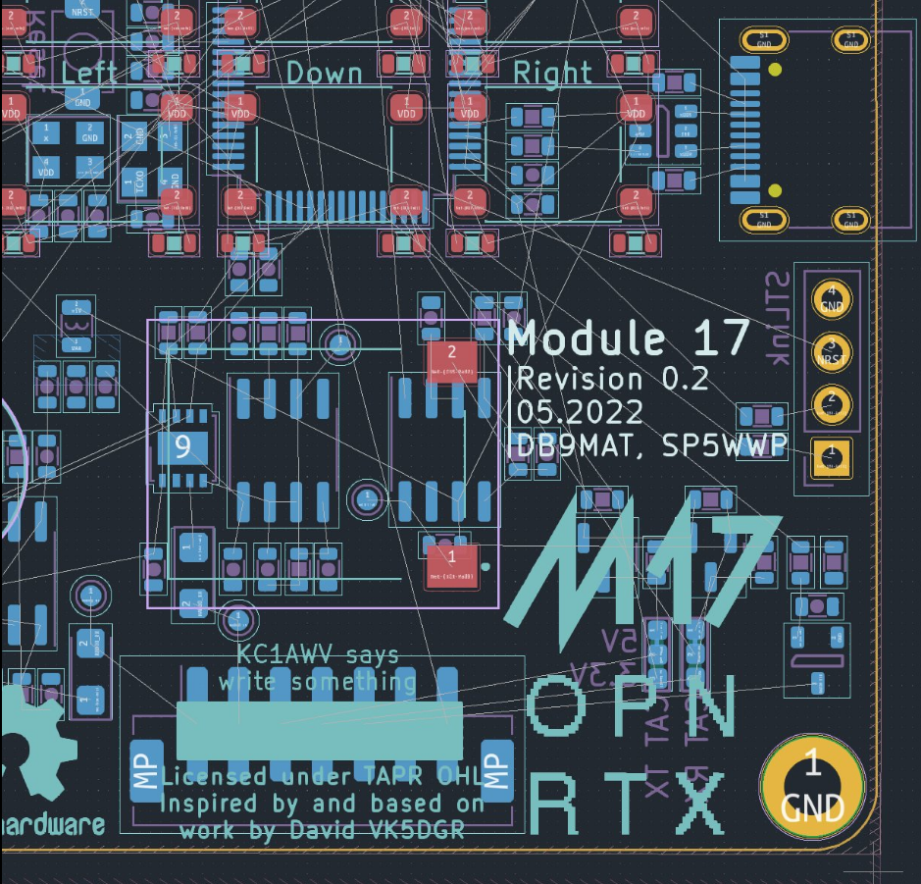

Slide 15
2022
Steve KC1AWV and Ed N2XDD give numerous interviews
QSO Today, Ham Radio 2.0, Ham Radio Crash Course,
KM4ACK, Tank Radio, DixieDX,...
Attendance at major ham festivals in the US
NEARfest/Deerfield, HamCation/Orlando, HamVention/Dayton,
HOPE/NYC, …

Slide 16
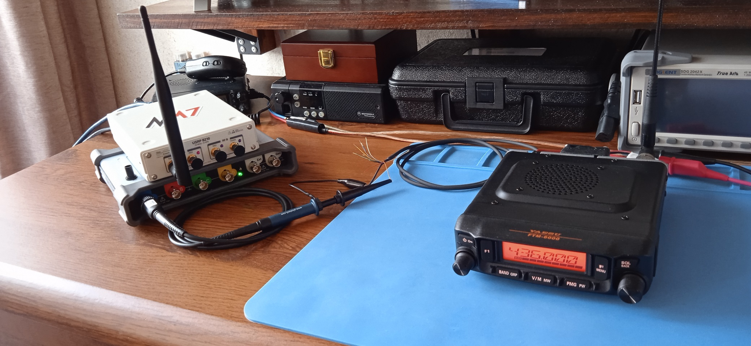
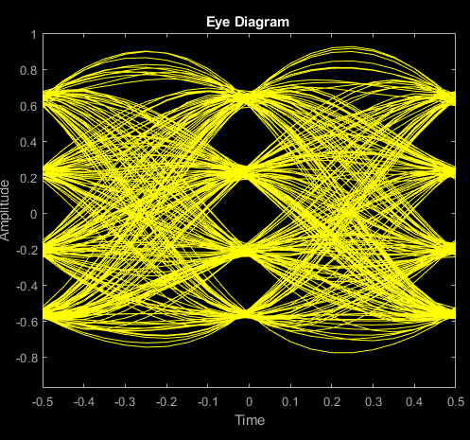

Slide 17
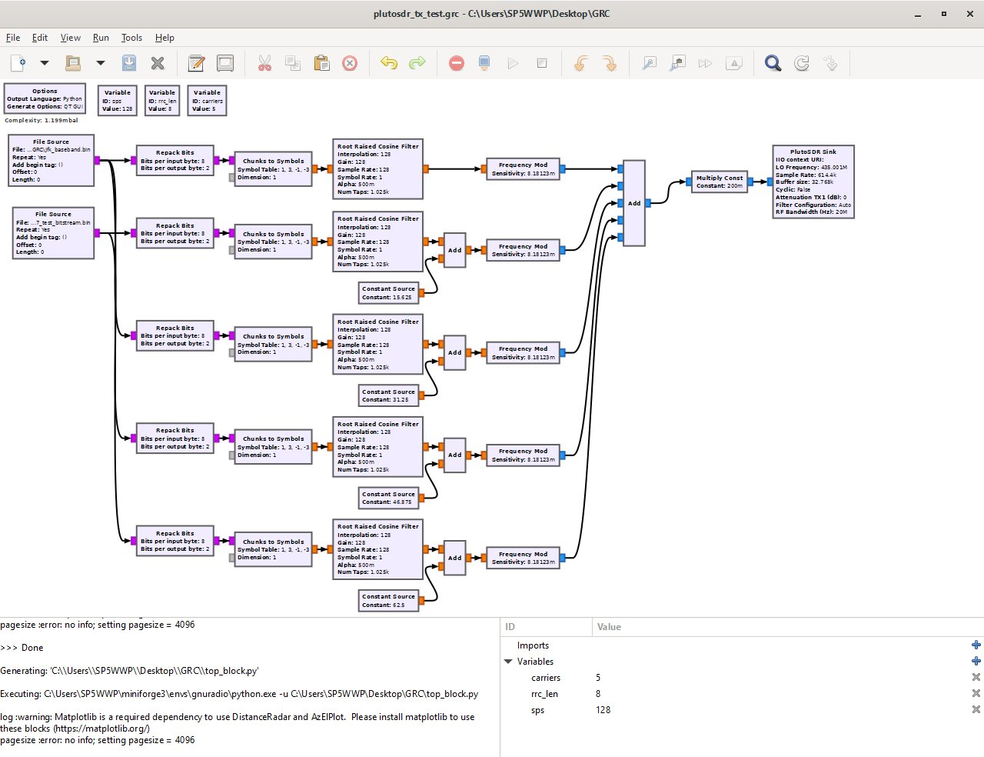
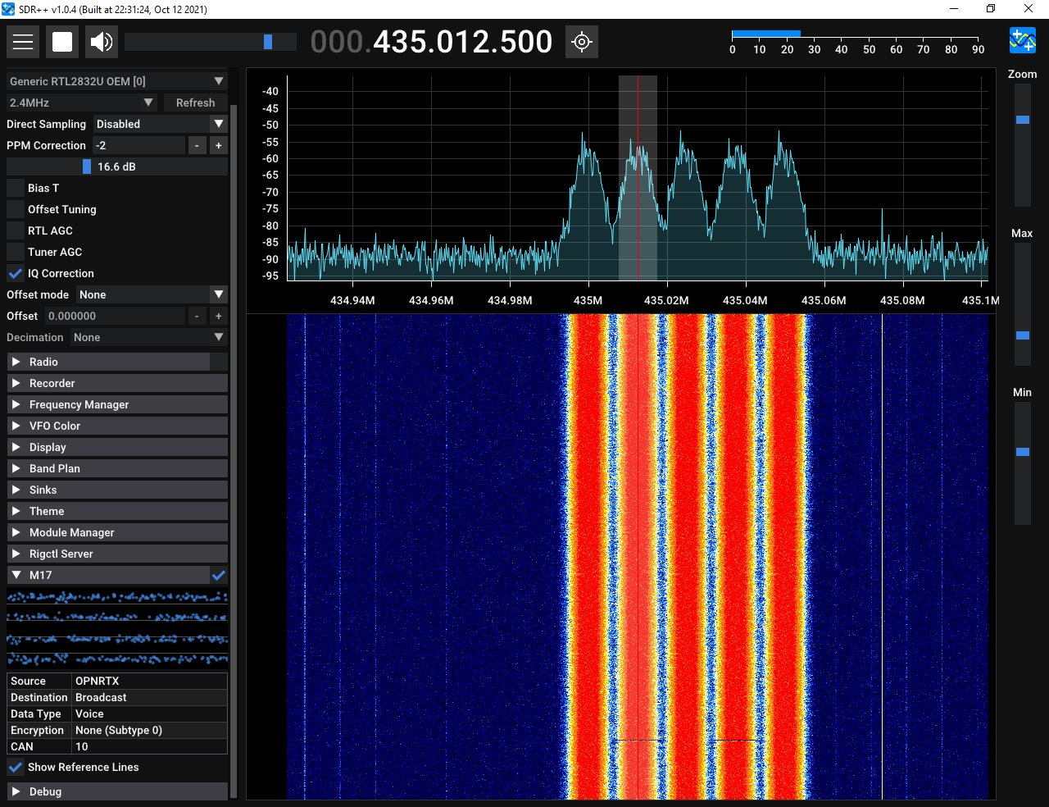

Slide 18
Some numbers
Over 130 reflectors worldwide
Over 1800 Twitter followers
More than 600 Discord chat users
“M17” Wikipedia article in 5 languages

Slide 19
Physical layer
4FSK modulation, 12.5 kHz channels
4800 symbols per second, 9600 bps gross throughput
Stream and packet modes
Error-control coding

Slide 20
Additional features
IDs are based on callsigns (no user ID database needed)
16 Channel Access Numbers
AES encryption support

Slide 21
Questions?

Slide 23
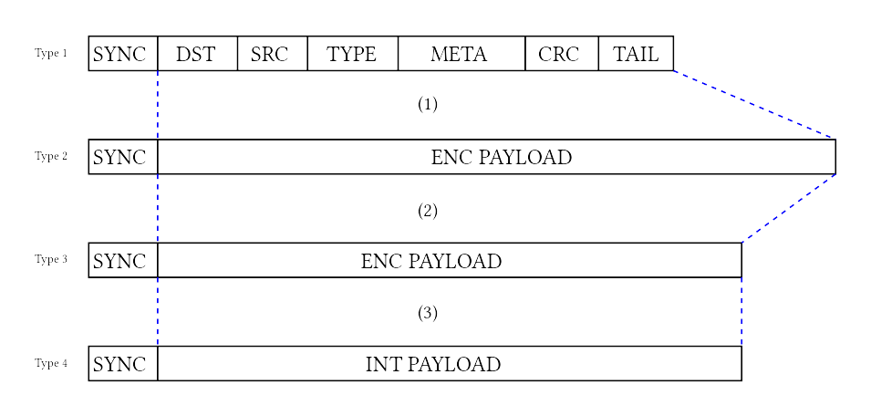
Link Setup Frame (LSF)

Slide 24
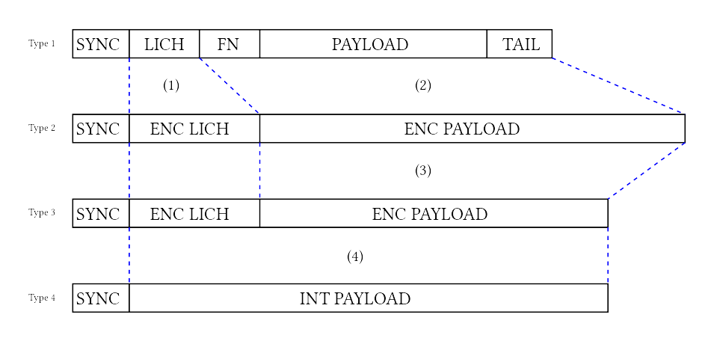
Voice frame

Slide 25
Error-control coding
Golay (24, 12)
Punctured convolutional coding
Bit interleaving (re-ordering)

